Slide 1
Managing and Monitoring Windows 7 Performance
Lesson 8

Slide 2
Objectives
Configure Windows Updates with Windows Update Client and WSUS
Monitor Windows Performance using Event Viewer, Performance Information and Tools, Performance Monitor, and Reliability Monitor
Manage Windows Performance using Task Manager, Resource Monitor, Process Explorer, and System Configuration
Notes:
Outline the material you are going to cover in this lesson. Do not go into detail as each of these points will be expanded on in the lesson. You may also want to mention the Technology Skills that are being covered for the Certification exam also.

Slide 3
Updating Windows 7
Current operating systems are always a work-in-progress, constantly being updated to correct errors, enhance performance, and add features.
One of the primary tasks of a desktop technician
Should be familiar with:
Types of update releases
Methods for deploying updates
Notes:
Introduce Windows Updates.

Slide 4
Understanding Update Types
Hotfixes
Security updates
Cumulative updates (rollups)
Service packs
Notes:
Describe each update type.

Slide 5
Update Categories
Important updates
Recommended updates
Optional updates
Device drivers
Notes:
Describe the meanings of the different update categories and how you can use the categories to choose what should be updated.

Slide 6
Applying Updates
Windows Update
Windows Server Update Services (WSUS)
System Center Configuration Manager (SCCM)
Notes:
Explain the different ways companies can choose to update their Windows 7 computers. SCCM is formerly known as SMS.

Slide 7
Important Updates Options
Install updates automatically (recommended)
Download updates but let me choose whether to install them
Check for updates but let me choose whether to download and install them
Never check for updates (not recommended)

Slide 8
Using Windows Server Update Services
Downloads updates from the Microsoft Update Web site
Stores them for administrator evaluation
Administrators select the updates to deploy
Computers on the network download updates from WSUS server using a reconfigured Windows Update Client
Notes:
Describe the disadvantages of having each workstation download their own updates from Microsoft Updates and introduce WSUS as the solution.

Slide 9
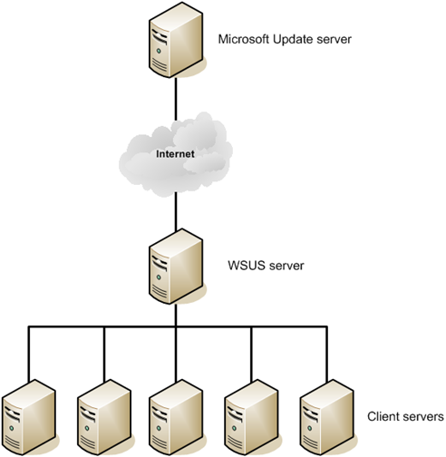
Understanding WSUS Architecture
Notes:
Use this basic architecture diagram to describe how WSUS works. Refer to other Architecture diagrams in the textbook to talk about other configurations for larger networks.

Slide 10
Monitoring Performance
For a computer to perform well, all of its components must be efficient.
Windows includes tools to enable you to locate poorly performing components (bottlenecks):
Event Viewer
Performance Information and Tools
Performance and Reliability Monitor
Notes:
Introduce the concept of Performance Monitoring and why we do it. Introduce the tools being discussed.

Slide 11
Using Event Viewer
Primary function is to record information about system activities as they occur and package that information into individual units, called events.
Event Viewer is the tool you use to view these events.
Events are stored in log files:
System Log, Security Log, and Application Log
Setup Log and Forwarded Events
Notes:
Introduce the Event Viewer Snap In and the 3 main logs that are used to store Event information.

Slide 12
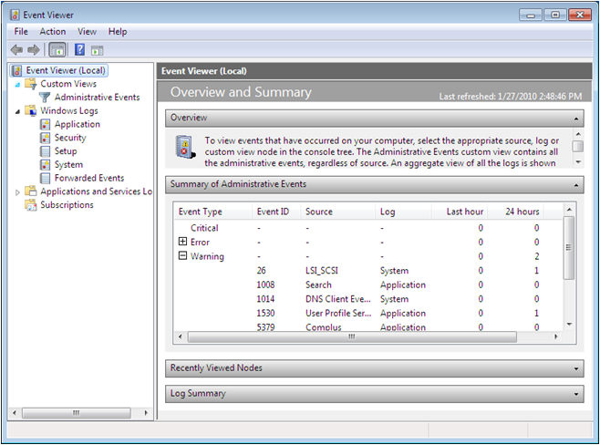
Using the Overview and Summary Display
Notes:
Describe what you see in the Summary of Administrative Events and explain that you can expand on any event type. Point out the different Windows Logs.

Slide 13
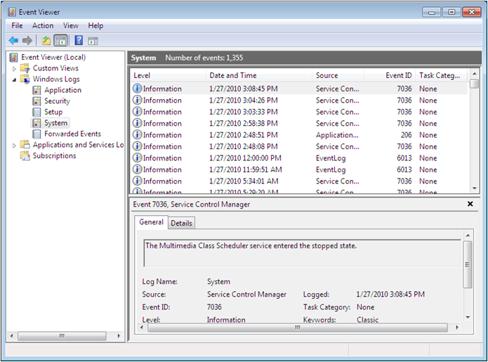
Viewing Windows Logs
Notes:
Explain that the System Log is the primary operational log. Describe the 4 different event types that can be seen in a log file: Information, Error, Warning and Critical.

Slide 14
Performance Information and Tools
Rates computer’s components and assigns a base score reflecting the score of the lowest rated component on your system – The bottleneck.
Hardware upgrades improve performance.
Conserve system resources to enhance performance – Tips for improving your computer’s performance link.
Notes:
See notes for next slide and use this text and the next slide to explain the concepts.

Slide 15
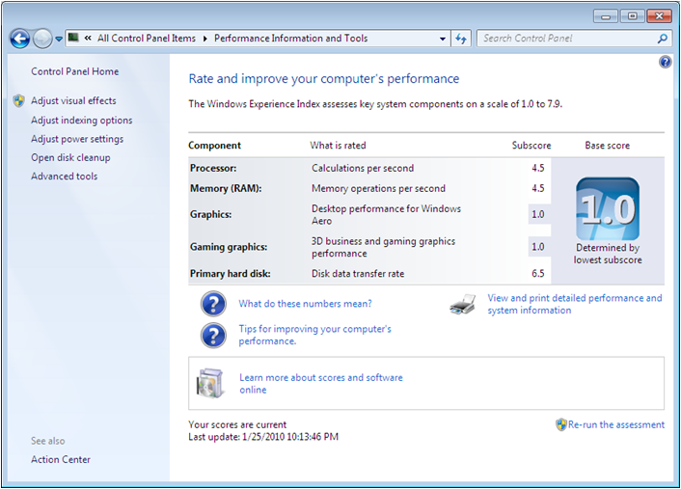
Performance Information and Tools
Notes:
Explain the Windows Experience Index. Explain how the tool breaks the computer down into 5 components, each of which is given a numerical score to gauge its performance. The base score will be the lowest scored component. To increase computer performance, you should try to raise the system’s base score. Discuss ways of increasing the base score. Discuss using the Tips for improving your computer’s performance to enhance the computer’s performance without upgrades.

Slide 16
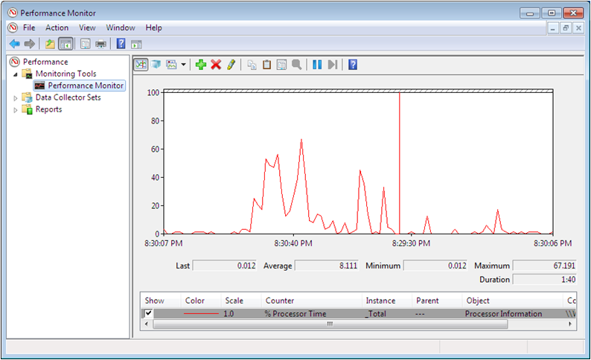
Using the Performance Monitor Console
Notes:
Performance Monitor console enables you to view similar information to the Performance Information and Tools information, but on a continuous, real-time basis. Performance Monitor is a tool that can display information for hundreds of different statistics (called performance counters) in a variety of ways. You can use Performance Monitor to create a customized graph or report containing any statistics you choose.

Slide 17
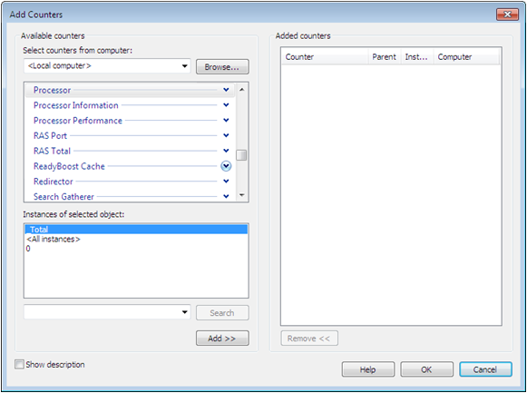
Adding Counters
Notes:
Explain the concept of adding Counters to the Performance Monitor and describe the 4 pieces of information you see on the screen: computer, Performance object, Performance Counter, Instance

Slide 18
Creating an Effective Display
Limit the number of counters
Modify the counter display properties
Choose counters with comparable values
Notes:
Explain how to create an effective display and why it is important.

Slide 19
Managing Performance
Windows 7 includes a variety of controls and technologies that enable technical specialists to enhance and fine-tune the performance of their workstation:
Task Manager
Resource Monitor
Process Manager
System Configuration tool
Notes:
Introduce the concept of managing performance and briefly introduce the tools.

Slide 20
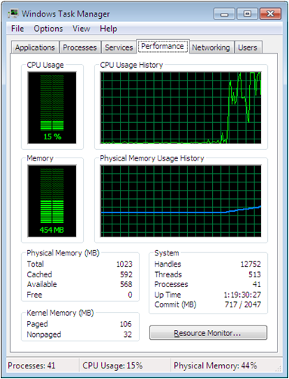
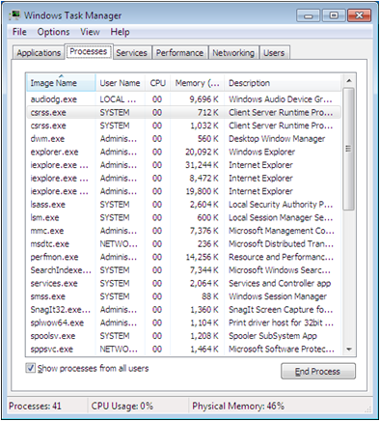
Task Manager
Notes:
Use the screen shots on the slide to describe the ways the Task Manager can help you to manage performance and processes on your computer.

Slide 21
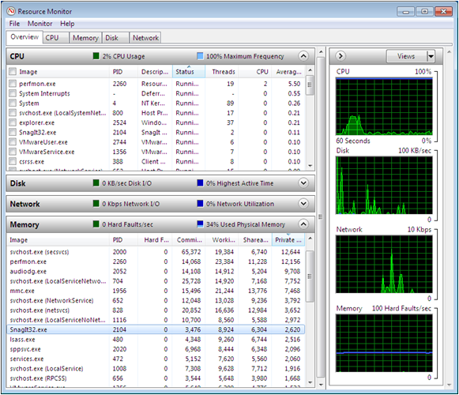
Resource Monitor
Notes:
The Resource Monitor window displays a more comprehensive breakdown of process and performance statistics. Discuss the statistics shown on the screen.

Slide 22
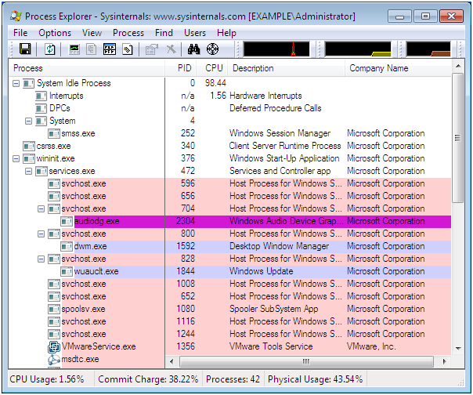
Using Process Explorer
Notes:
For even greater statistical detail, you can download the Process Explorer application from Microsoft’s web site

Slide 23
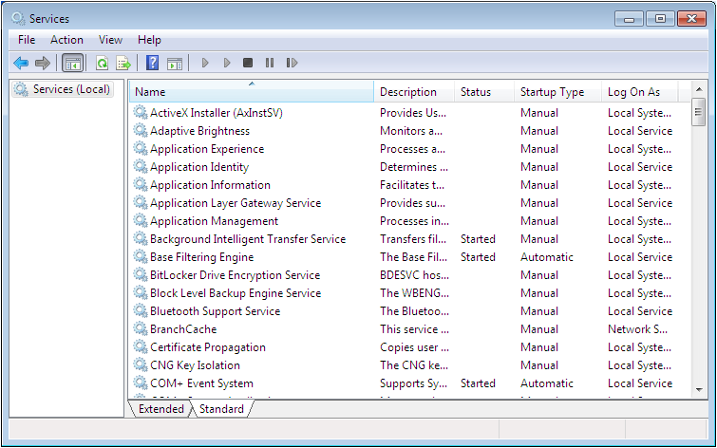
Managing Services
Notes:
Windows 7 loads a large number of services automatically when the computer starts. Disabling the services he workstation does not need can free up resources and improve the computer’s performance.

Slide 24
Using ReadyBoost
Enables you to use the storage space on a USB flash drive to free up system memory for other uses
Notes:
Explain the enhancements of ReadyBoost over Vista. Explain how it uses the non-volatile memory cache for SuperFetch information. Explain SuperFetch

Slide 25
Tasks
Do Lab 11 (MOAC)
Do Lesson 8 Test 192.168.40.93
Lesson review Questions 2 Record Score
Send lab resource sheet to tutor
Complete Q & A sheet (issued by tutor) using Text book only

